Slide 1

Pepper– Social Robot
Guides
Lior Rokach & Shelly Levy Tzedek
Students
Itamar Zigel – 204381685 , Zahi Kapri – 307881276
Itzhak Finkelstein – 203640271 ,Noa Weiss – 312427404
Notes:
“Here is where your presentation begins” – you might want to remove this

Slide 2
The Problem
Post-stroke rehabilitation process is demanding and exhausting, both from a patient and physiotherapist point of view.

Slide 3
The Solution
Our team will make a system which will be able the simulate the physiotherapist analyzing the patient’s movement using Pepper the social robot to give the patient feedback according to compensations in his movement.

Slide 4


Difference
The existing system
Trio cameras
Edit a CSV file
Matlab code
Analysis of Results
Motive
Python code
Pepper/
Computer
Physical game
Arduino
Our system

Slide 5
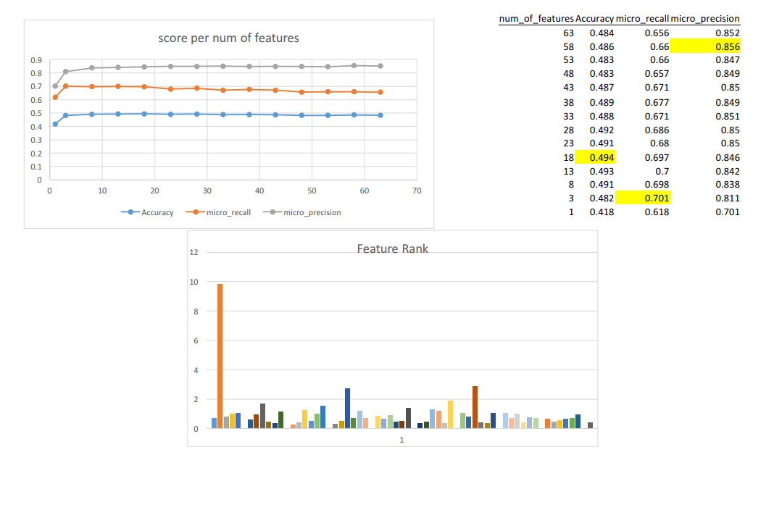

Slide 6
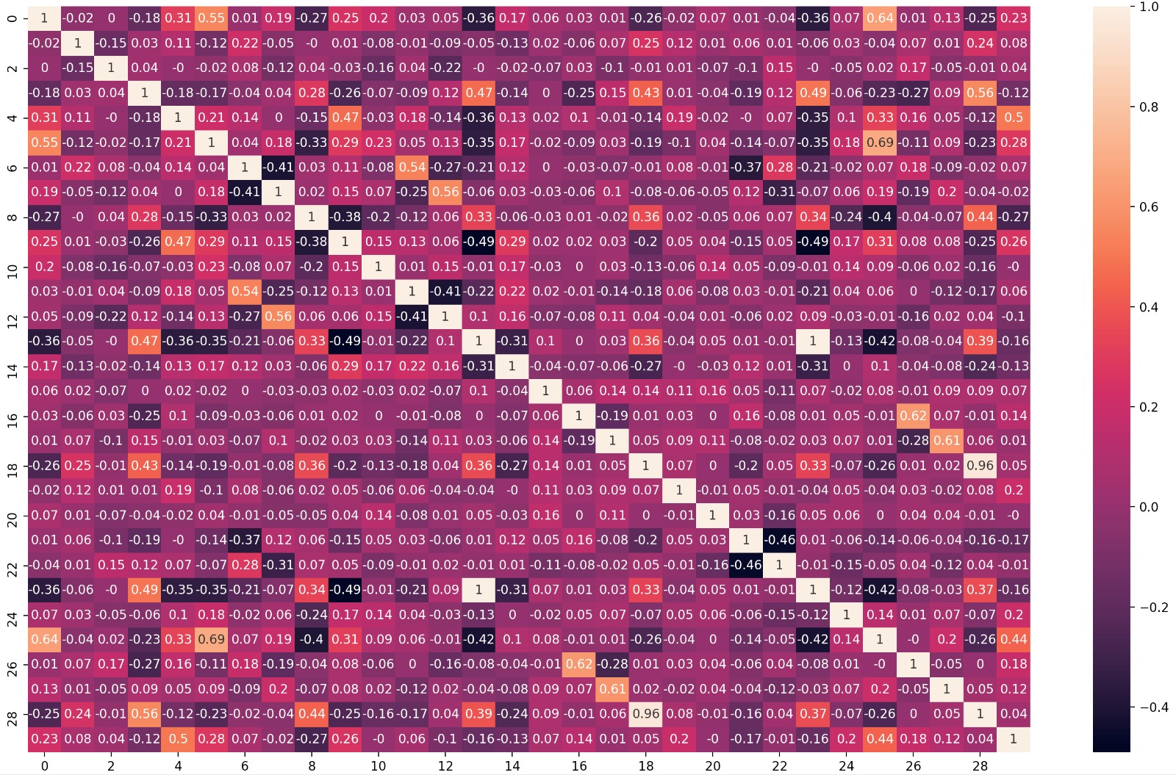

Slide 7
Algorithm (Server)
Pepper Reaction Handler (Server)
Main Application (Client)
About the project
Figure of process

